Slide 1
Sciencebois
Avery Pawelek
Negin Rahbar
Russel Gates
Tomi Ulobeko
Dylan Cooledge

Slide 2
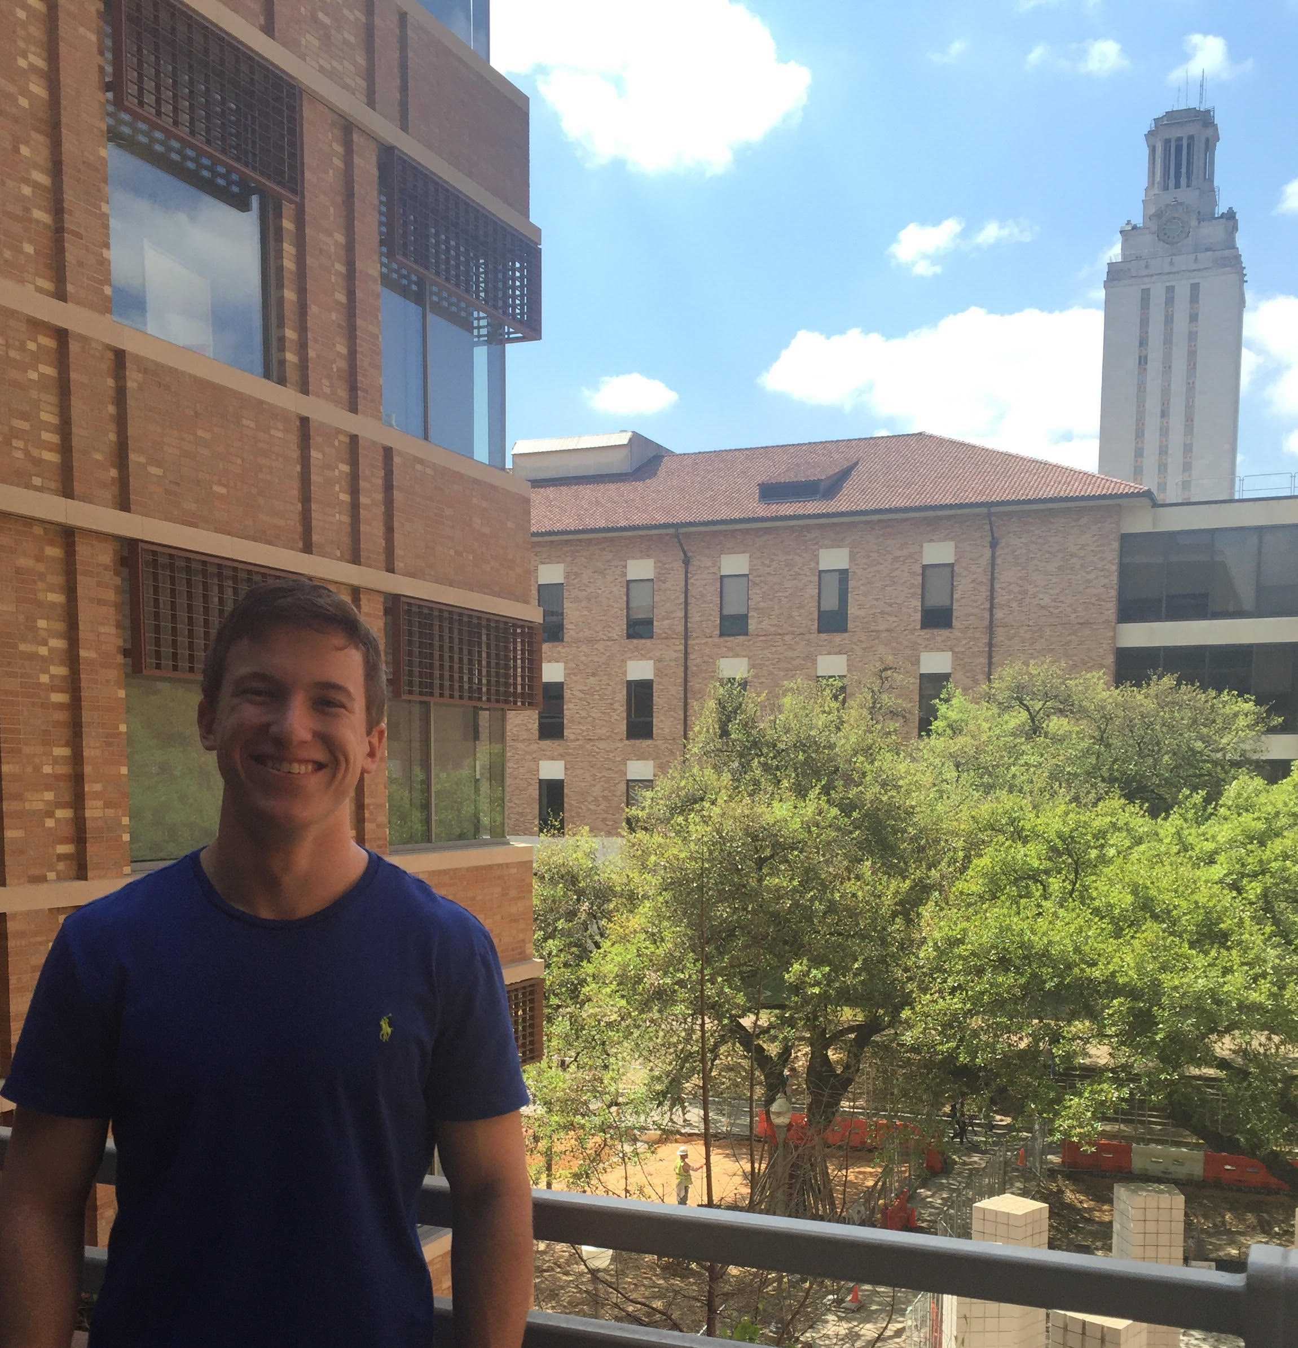
Avery Pawelek
I am a physics and mathematics student from a tiny town.
Responsibilities:
Scientific Fields model
Scientific Fields pages
Linking of pages
Meeting organizer
13 commits

Slide 3
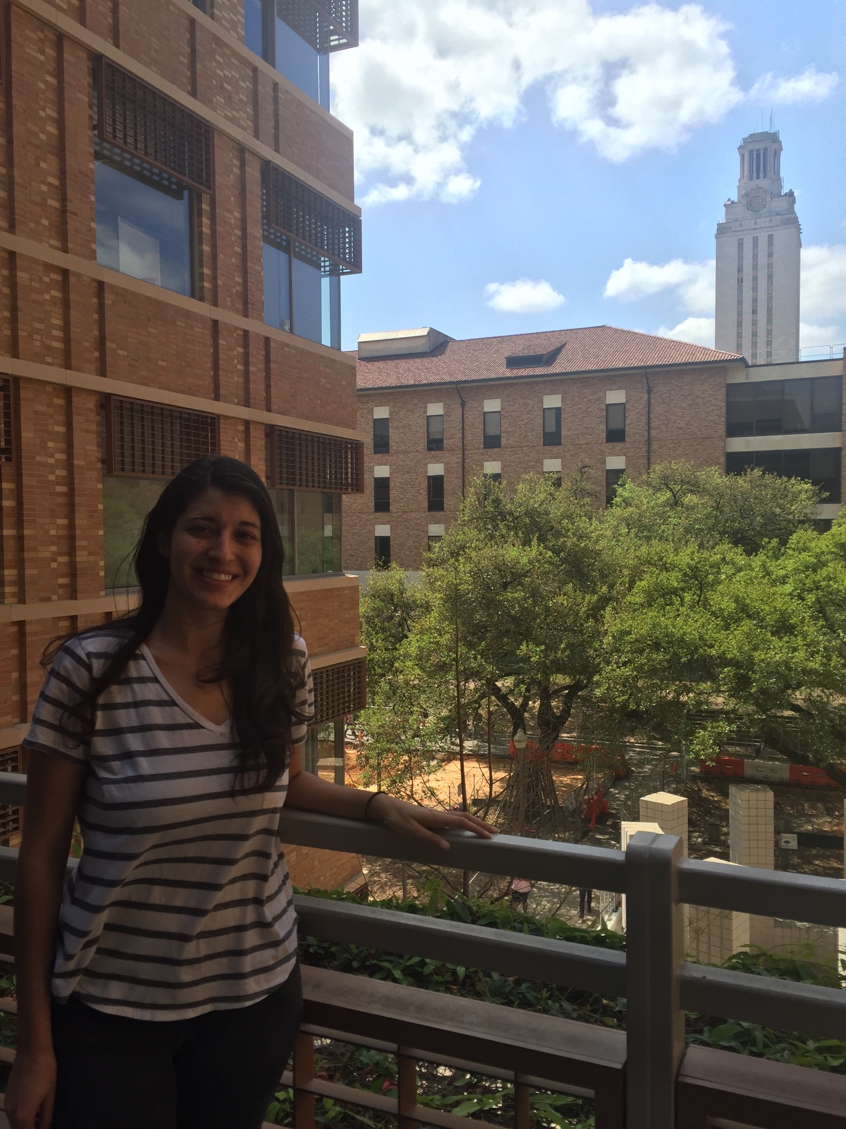
Negin Rahbar
I am not afraid to commit.
Responsibilities:
CSS
Technical Report
Splash page
6 issues
39 commits

Slide 4
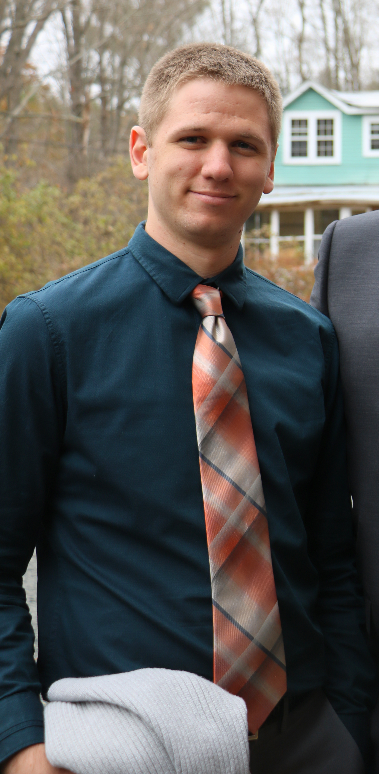
Russell Gates
Mathematics major at The University of Texas at Austin by day, Sm4sh noob by night.
Responsibilities
Hosting
Page Navigation
Documentation
17 commits
10 issues

Slide 5
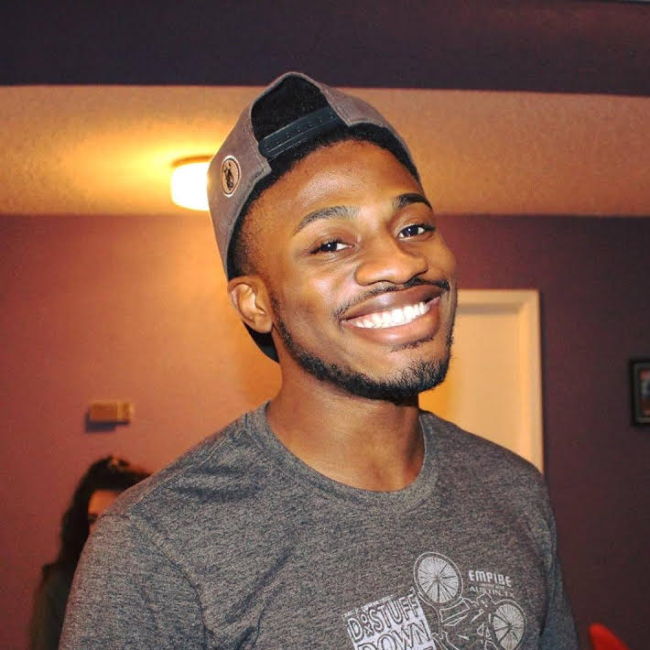
Tomi Olubeko
Mathematics Major at UT. I enjoy playing soccer and pwning Rusty at Smash.
Responsibilities:
Made the table for the theories
Made the theory html pages
5 commits
Added pagination to theorymodel.html
Added pagination to scientistmodel.html
Added pagination to fields.html

Slide 6
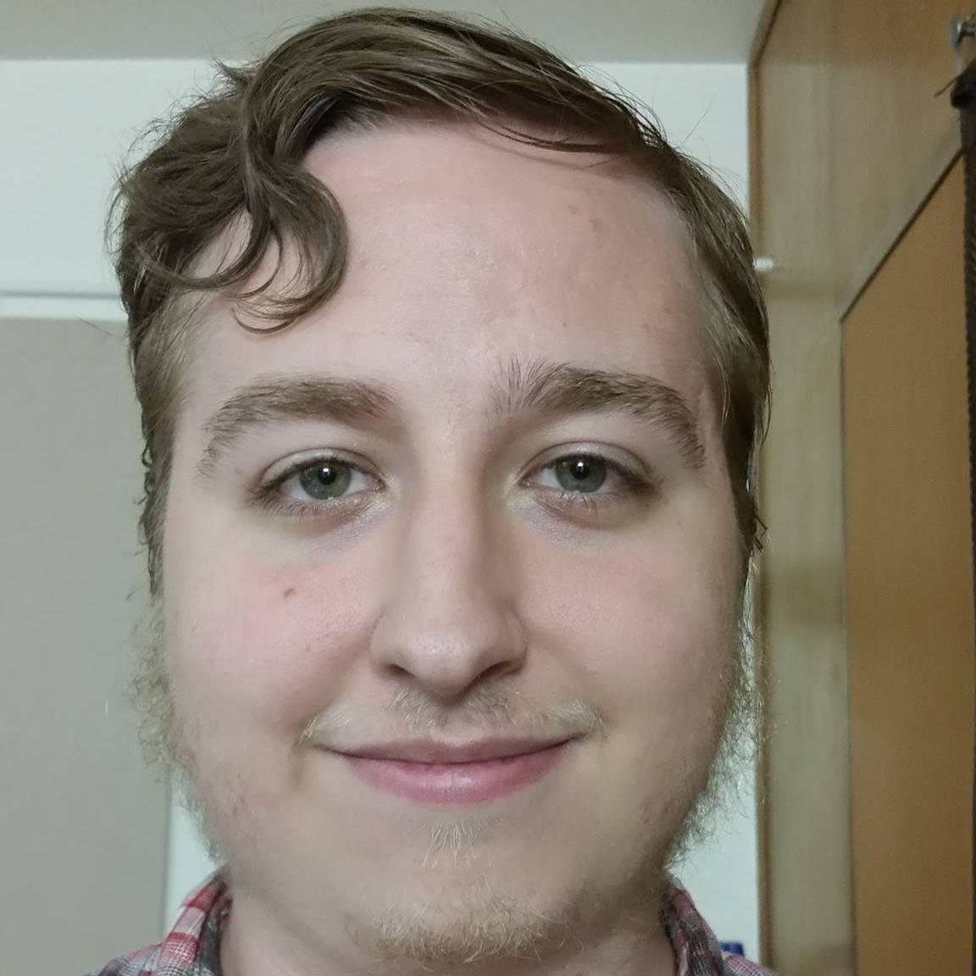
Dylan Cooledge
I like computer science and robots.
Responsibilities:
Scientists model
Scientists' pages
28 commits
6 issues

Slide 7
Demo…

Slide 8
User Stories
The website should be hosted on Digital Ocean.
The backend must be implemented using Python and Flask.
Create presentation that showcases the user requirements and the developer response.
Implement the frontend using bootstrap.
The website should have sortable tables.

Slide 9
Self Critique

